Slide 1

Task 16
Seamless Scan-Based
Trading at Wal-Mart
Michael I. Shamos, Ph.D., J.D.
Director, eBusiness Programs
Institute for Software Research
Carnegie Mellon University

Slide 2
Task 16
Design a seamless shopping app/server system
  Identify products selected by the user
  Support consumer payment methods
Design a scan-based trading (SBT) payment system for Wal-Mart
  Compute how much Wal-Mart owes each supplier each day
  Transmit payment orders to cause payment to occur

Slide 3
Outline
How Payments are Made
  Gross v. net settlement
  Consumer payments: credit cards, PayPal
  B2B Payments
    Wire transfer, ACH, PayPal
Financial messaging
  SWIFT (Society for Worldwide Interbank Financial Telecommunication)
Mobile Payments
  Credit/debit card, NFC
Scan-Based Trading (SBT)
Appendix: ApplePay

Slide 4
The Fundamental Payment Problem
Parties cannot pay each other directly, except in cash¹
Payment
Buyer’s
Bank
Seller’s Bank
How does one bank
pay another bank?
Advice of
payment (AOP)
Payment
order
Messaging &
Trade Information
BUYER
SELLER
¹Or possibly in Bitcoin
SOURCE: DEBRA MITTERER

Slide 5
Central Banks
Currency is issued by (or under the authority of) a central bank
The U.S. central bank is the Federal Reserve Bank
  PRC: People’s Bank of China (PBOC)
  India: Reserve Bank of India
Commercial banks hold very little cash (just enough for tellers and ATMs)
Commercial banks have accounts at the central bank
Most bank money is not in cash, but is a ledger entry (account) in a database at the central bank
Notes:
52

Slide 6
How Banks Pay Each Other
They give instructions to the central bank to “move money” by updating their accounts in the central bank
If Citibank wants to move USD 1 million to PNCBank, it sends an order to the central bank:
ACCOUNTS AT
THE CENTRAL BANK
PNCBANK
BANK A
. . .
BANK Z
CITIBANK
ACCOUNTS AT
THE CENTRAL BANK
PNCBANK
BANK A
. . .
BANK Z
CITIBANK
1,134,299,321
1,135,299,321
USD
1,000,000
2,107,071,775
2,106,071,775
BEFORE TRANSFER
AFTER TRANSFER

Slide 7
Fedwire: How Banks Pay Each Other
Central banks maintain “real-time gross settlement systems (RTGS) to execute payment instructions quickly
The Federal Reserve RTGS is called Fedwire
“Real-time” means less than 1 minute
“Gross settlement” means that each order is processed as it is received. No batching
These payments are called “wire transfers”
RTGS payments are expensive: up to USD 50 per payment
Used mainly for large amounts (average on FedWire: USD 3.5M)
Notes:
52

Slide 8
Net Settlement
Most consumer (small) payments, such as ATM and credit card transactions are not made in real-time with RTGS
The data is sent to a clearing house
Clearing house keeps track of the net amounts owed or owing from bank to bank
Each transaction causes these amounts to be adjusted
After a clearing period (e.g. 1 day), each bank is told the total amount it must pay or will receive
Banks then use RTGS (in the U.S., Fedwire) to settle their TOTAL debts with ONE payment each
Notes:
52

Slide 9
Net Settlement
Many payments are small and do not have to be made in real-time. The cost of RTGS is not justified
Payments can be batch and settlement made for the whole batch later
Net settlement through an automated clearing house (ACH) is used for:
  credit/debit cards
  checks
  ATM withdrawals, credit transfers
BUT: there is no upper limit on ACH payments
Cost is low: about USD 0.10 per payment, 500 times cheaper than RTGS
Notes:
52

Slide 10
Payment Orders
An instruction to a financial institution to make a payment
Must specify:
  Amount & currency
  Bank FROM which payment is made (payor or drawee bank)
  Account number FROM which payment is made
  Bank TO which payment is to be made (payee bank)
  Account number TO which payment is to be made
Payment orders are often sent electronically to the clearing house as “ACH files”
These payment orders are NOT settled individually. They are BATCHED to determined their net effect
Notes:
52

Slide 11
Clearing Payment Orders
CUSTOMER CMU
OF MELLON BANK
1. CMU SENDS CHECK TO SHAMOS
CUSTOMER SHAMOS
OF CITIBANK
“PAY SHAMOS $100”
9. MELLON SENDS
CHECK BACK TO CMU
2. SHAMOS DEPOSITS
CHECK AT CITI
MELLON BANK
CUSTOMER A
CUSTOMER CMU
. . .
CUSTOMER Y
CUSTOMER Z
8. CLEARING HOUSE
SENDS CHECK TO
MELLON
CITIBANK
CUSTOMER A
CUSTOMER B
. . .
SHAMOS
CUSTOMER Z
4. CITI SENDS CHECK
TO CLEARING HOUSE
-100
AUTOMATED
CLEARING HOUSE
MELLON
BANK A
. . .
BANK Z
CITIBANK
+100
-100
7. MELLON
DEDUCTS $100
FROM CMU
ACCOUNT
6. CLEARING
HOUSE SENDS MELLON
DEBIT INFO
3. CITIBANK CREDITS
SHAMOS WITH $100
+100
5. CLEARING HOUSE ADDS $100 TO CITI,
SUBTRACTS $100 FROM MELLON

Slide 12
Settling Payment Orders
1. AT END OF DAY, EACH
BANK HAS A NET POSITIVE
OR NEGATIVE CLEARING
HOUSE BALANCE
REAL-TIME GROSS
SETTLEMENT SYSTEM
(FEDWIRE)
MELLON
BANK A
. . .
BANK Z
CITIBANK
CLEARING
HOUSE
    2. BANKS WITH NEGATIVE
BALANCES MUST PAY;
THOSE WITH POSITIVE
BALANCES RECEIVE
MONEY
+34,299,321
6. CLEARING HOUSE PAYS
MELLON $34,299,321
4. CITI PAYS THE CLEARING
HOUSE THROUGH RTGS
-107,071,775
MELLON BANK
CUSTOMER A
CUSTOMER CMU
. . .
CUSTOMER Y
CUSTOMER Z
CITIBANK
CUSTOMER A
CUSTOMER B
. . .
SHAMOS
CUSTOMER Z
+107,071,775
-15085
+2786
+3167
AUTOMATED
CLEARING HOUSE
MELLON
BANK A
. . .
BANK Z
CITIBANK
-988713
+728103
+100
+35529
+34,299,321
-31872
5. CLEARING HOUSE ADVISES
MELLON IT WILL
RECEIVE $34,299,321
3. CLEARING HOUSE INFORMS
CITI IT MUST PAY $107,071,775
-107,071,775

Slide 13
Gross Settlement
CENTRAL BANK
BUYER’S
BANK
SELLER’S
BANK
SELLER
BUYER

Slide 14
Gross Settlement
CENTRAL BANK
3. CENTRAL BANK ADJUSTS BALANCES
OF BUYER’S BANK AND SELLER’S BANK
2. BUYER’S BANK USES
FEDWIRE TO ASK FED TO
MOVE MONEY FROM BUYER’S
BANK TO SELLER’S BANK
4. CENTRAL BANK NOTIFIES SELLER’S
BANK OF TRANSACTION
BUYER’S
BANK
SELLER’S
BANK
1. BUYER SENDS PAYMENT
ORDER (WIRE TRANSFER)
TO BUYER’S BANK
5. SELLER’S BANK NOTIFIES
SELLER OF RECEIPT OF
MONEY
SELLER
BUYER

Slide 15



Net Settlement
CENTRAL BANK
BUYER’S
BANK
SELLER 1 BANK
SELLER 1
SELLER 2 BANK
SELLER 2
BUYER
SELLER 3 BANK
SELLER 3

Slide 16
Net Settlement, Part 1
CENTRAL BANK
BUYER’S
BANK
2. BUYER’S BANK SENDS
ACH TRANSACTIONS
TO CLEARING HOUSE
SELLER 1 BANK
SELLER 1
1. BUYER SENDS ACH
FILE (CREDIT
TRANSFERS) TO
BUYER’S BANK
4
4
SELLER 2 BANK
SELLER 2
3. CLEARING HOUSE CONTINUOUSLY
DETERMINES THE NET EFFECT OF
ALL TRANSFERS
4. AT END OF DAY, CLEARING HOUSE
TELLS EACH DEBTOR BANK HOW
MUCH IT MUST PAY
BUYER
SELLER 3 BANK
SELLER 3

Slide 17
Net Settlement, Part 1
CENTRAL BANK
5. BUYER’S BANK (WHICH MAY
BE A DEBTOR, SENDS AN
ORDER BY FEDWIRE
5. SELLER BANK 1 (WHICH MAY
BE A DEBTOR(, SENDS AN
ORDER BY FEDWIRE
6. FED CREDITS THE
CLEARING HOUSE
WITH FUNDS FROM
BUYER’S BANK AND
SELLER BANK 1
BUYER’S
BANK
SELLER 1 BANK
SELLER 1
SELLER 2 BANK
SELLER 2
5. DEBTOR BANKS PAY THE CLEARING
HOUSE BY FEDWIRE
BUYER
SELLER 3 BANK
SELLER 3

Slide 18
Net Settlement, Part 2
CENTRAL BANK
5. BUYER’S BANK (WHICH MAY
BE A DEBTOR, SENDS AN
ORDER BY FEDWIRE
8. FED CREDITS THE
ACCOUNTS OF THE
CREDITOR BANKS
AND NOTIFIES THEM
OF PAYMENT
9. CREDITOR BANKS
NOTIFY SELLERS
OF PAYMENT
BUYER’S
BANK
7. CLEARING HOUSE
SENDS ORDERS
TO THE FED BY
FEDWIRE
SELLER 1 BANK
SELLER 1
SELLER 2 BANK
SELLER 2
7. CLEARING HOUSE PAYS THE CREDITOR
BANKS BY FEDWIRE
IN NET SETTLEMENT,
EVERY BANK MAKES OR
RECEIVES EXACTLY ONE
PAYMENT
BUYER
SELLER 3 BANK
SELLER 3

Slide 19
Credit Card Authorization
SOURCE: MASTERCARD
Notes:
52

Slide 20
Credit Card Clearing
Credit card settlement is net settlement but the card association (Visa, MasterCard) acts as the clearing house
SOURCE: MASTERCARD
Notes:
52

Slide 21
Financial Messaging
Money never actually moves, except in cash form
Most money is transferred by sending messages – payment orders – to and from banks
Banks also send messages to their customers to advise of payments
Financial messaging is ESSENTIAL to payment systems
BUT: a financial message is NOT a settlement

Slide 22
S.W.I.F.T.
Society for Worldwide Interbank Financial Telecommunication
Non-profit, headquarters in Brussels
Financial messaging system ONLY
  NOT A PAYMENT SYSTEM
  No accounts, no clearing, no settlement
  Settlement must occur separately
4.6 billion messages/yr
Amounts in messages: USD 7 trillion value per day
Cost ~ $0.20 per message; transit time 20 seconds
Private IP network, NOT the Internet
SOURCE: SWIFT
Notes:
52

Slide 23
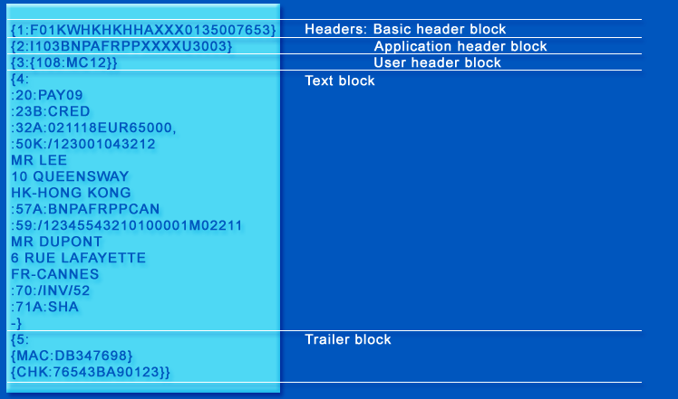
A SWIFT Message
103 = REMITTANCE
108 = MESSAGE REF
:20 TRANSACTION REF #
:23B BANK OPERATION: CREDIT
:32A VALUE DATE, CURRENCY, AMOUNT
:50K ORDERING INSTITUTION
:57A ACCOUNT WITH INSTITUTION
:59 RECIPIENT
:70 REMITTANCE INFORMATION, REASON FOR PAYMENT
:71A DETAILS OF CHARGES.
SHA = SHARED TRANSFER CHARGES
MAC = MESSAGE AUTHENTICATION CODE
CHK = CHECKSUM

Slide 24
SWIFT E-payments Plus System
Buyer's bank
Seller's bank
Payment
SWIFTNet
Link
SWIFTNet
Link
SWIFTNet
Payments
application
Payments
application
Payment Initiation
Initiation Response
Initiation
Confirmation
e-paymentPlus
Payment Initiation
Initiation
Confirmation
Initiation
Confirmation
TrustAct Server
TrustAct
Link
TrustAct
Link
Remittance advice
Remittance advice
Remittance advice
Invoices
Buyer
Seller
Internet
SOURCE: SWIFT

Slide 25
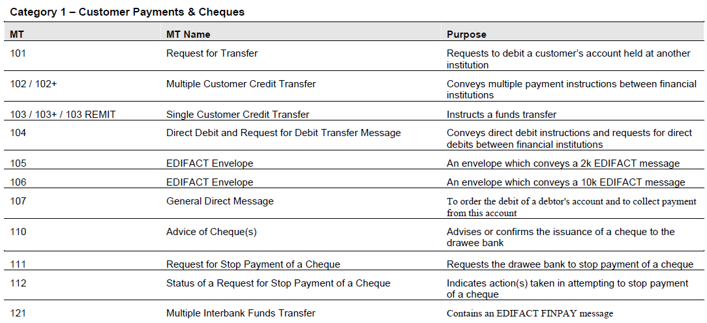
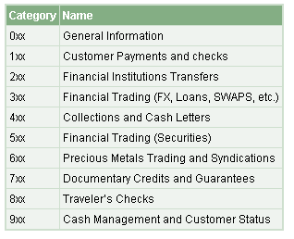
SWIFT Message Types
SEE ALL MESSAGE TYPES
Notes:
52

Slide 26
PayPal

Slide 27
PayPal Structure
PUBLIC COMPANY
(SPLIT OFF FROM EBAY)
BETWEEN TWO PAYPAL
USERS, TRANSACTIONS
ARE PURELY BOOK ENTRIES
ONLY MAINTAINS LEDGERS
NO MOVEMENT OF REAL
MONEY WITHIN PAYPAL
PayPal
GE Bank
IF REAL MONEY MUST
MOVE, PAYPAL SENDS
INSTRUCTIONS TO ITS
BANK
USER INTERACTS
WITH PAYPAL
THROUGH BROWSER
PAYPAL’s BANK
INTERACTS WITH
BANKING SYSTEM
THROUGH ACH
User
User’s Bank
USER MAINTAINS NORMAL
RELATIONS WITH HIS BANK
Notes:
52

Slide 28
PayPal Structure
PayPal Servers
User
PayPal Ledger
PATTY 1000
SHAMOS 0
INTERNET
BANKING SYSTEM:
Automated
Clearing
House
PayPal’s
Bank
Account
(GE Bank)
User’s
Bank
Notes:
52

Slide 29
Putting Money Into PayPal
PayPal Servers
User
PayPal Ledger
PATTY 1000
SHAMOS 0
INTERNET
“PLEASE ADD $2500
TO MY PAYPAL
ACCOUNT”
“PLEASE TAKE
$2500 FROM
SHAMOS’ BANK”
“ADD $2500
TO SHAMOS
IN LEDGER
CLEARING HOUSE
TELLS BANK
AMOUNT OWED
ACH DEBIT
Automated
Clearing
House
CLEARING HOUSE
PAYS PAYPAL’S
BANK
BANK PAYS
CLEARING HOUSE
User’s
Bank
PayPal’s
Bank
Account
(GE Bank)
Notes:
52

Slide 30
Putting Money Into PayPal
PayPal Servers
User
PayPal Ledger
PATTY 1000
SHAMOS 2500
INTERNET
“PLEASE ADD $2500
TO MY PAYPAL
ACCOUNT”
“PLEASE TAKE
$2500 FROM
SHAMOS’ BANK”
“ADD $2500
TO SHAMOS
IN LEDGER
CLEARING HOUSE
TELLS BANK
AMOUNT OWED
ACH DEBIT
Automated
Clearing
House
CLEARING HOUSE
PAYS PAYPAL’S
BANK
BANK PAYS
CLEARING HOUSE
User’s
Bank
PayPal’s
Bank
Account
(GE Bank)
Notes:
52

Slide 31
Paying A PayPal User
PayPal Servers
User
PayPal Ledger
PATTY 1000
SHAMOS 2500
INTERNET
“PLEASE PAY
PATTY $500”
Automated
Clearing
House
PayPal’s
Bank
Account
(GE Bank)
User’s
Bank
Notes:
52

Slide 32
Paying A PayPal User
PayPal Servers
User
PayPal Ledger
PATTY 1500
SHAMOS 2000
INTERNET
“PLEASE PAY
PATTY $500”
Automated
Clearing
House
PayPal’s
Bank
Account
(GE Bank)
User’s
Bank
Notes:
52

Slide 33
PayPal
It’s a big disk drive!
- $500
SHAMOS
PATTY
+ $500

Slide 34
Mobile Consumer Payments

Slide 35
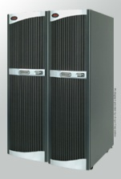
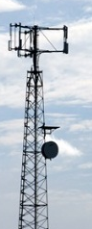


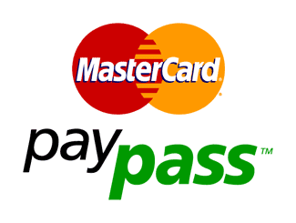


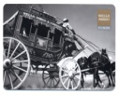

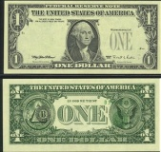
Payments Evolution
4
Over the Air
(OTA)
3
Contactless
Chip
Car parking
Vending machines
Peer-to-Peer payment
Ticketing
2
Octopus
Exxon Speedpass fob
PayPass chip in Mobile Phone
Magnetic Stripe
1
Cash/Checks
SOURCE: BOOZ ALLEN HAMILTON

Slide 36
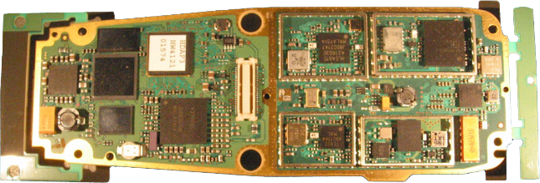
Smartphone Support for Seamless Shopping
1
2
3
4
5
6
7
DIVERSITY RX = MULTIPLE
ANTENNAS FOR SIGNAL
GAIN
Antennas
2,3,4G
Cellular
UWB
NFC
FM
diversity RX
WLAN
Blue tooth
DVB-H
GPS
8
9
10
11
DVB-H = DIGITAL VIDEO
BROADCASTING, HANDHELD
2G/3G/4G together with
NFC, UWB, WLAN, RFID, Bluetooth, FM Radio, GPS, …
SOURCE: NOKIA

Slide 37
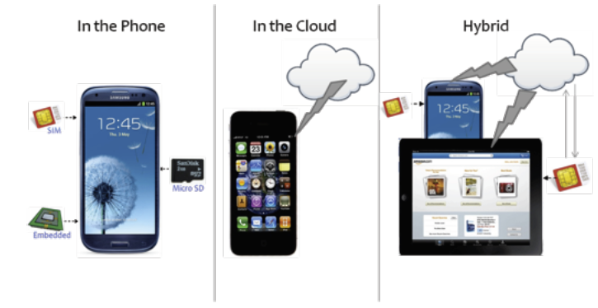
Storing Payment Credentials
Choices:
SOURCE: FIRST DATA
Notes:
52

Slide 38
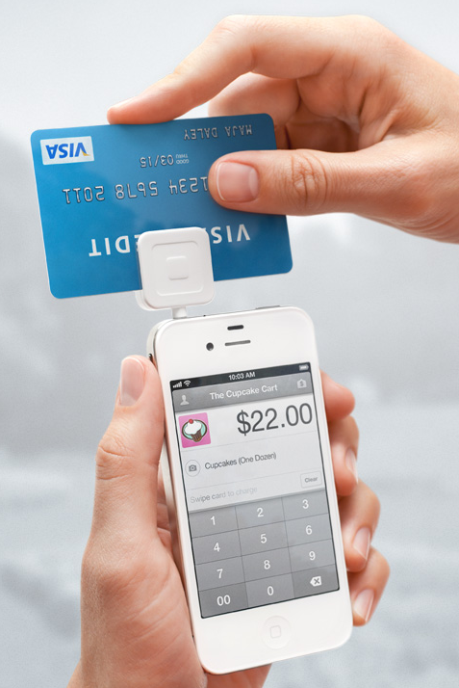

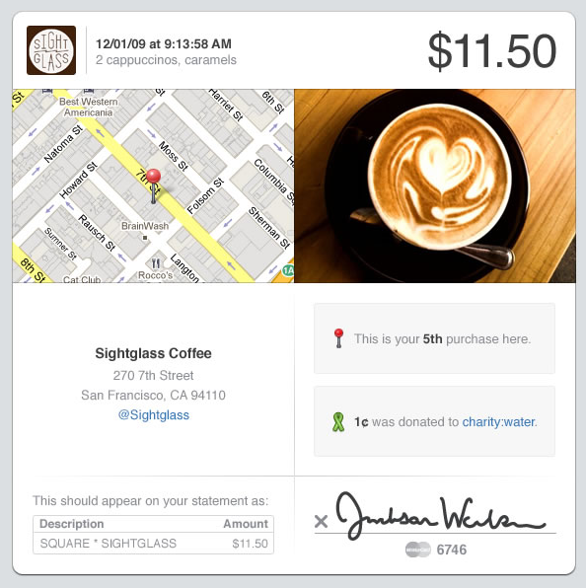
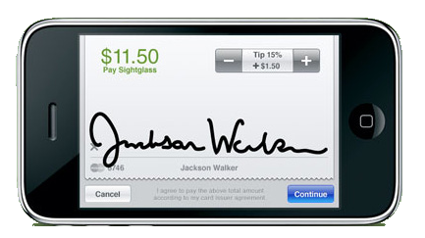
Accept credit cards from Android or iPhone
SWIPE
RECEIPT
SIGNATURE
SOURCE: SQUAREUP.COM
Notes:
52

Slide 39
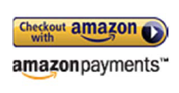
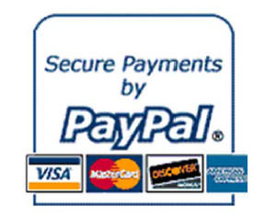


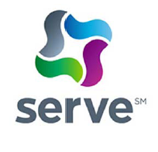
Online (Cloud) Model
User credentials are stored in the cloud, not on the mobile device
To pay, user is sent to a branded payment screen
Examples: Pago, PayPal, Serve, Google Checkout, Amazon Payments
SOURCE: T-MOBILE

Slide 40
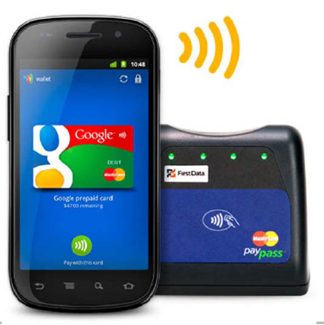
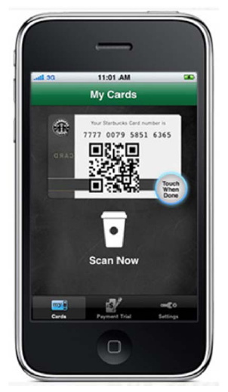
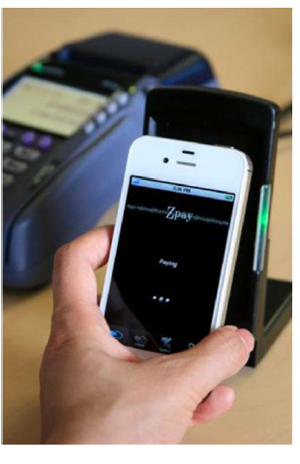
Contactless Model
Customer credentials are on the mobile device
Examples: Google Wallet, Isis, Paycloud (sound), Starbucks (QR codes)
SOURCE: T-MOBILE

Slide 41
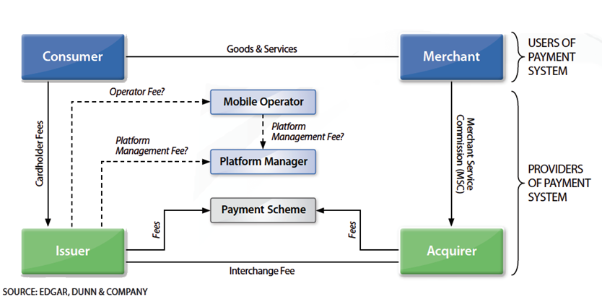
Participants in a Mobile Payment
Notes:
52

Slide 42
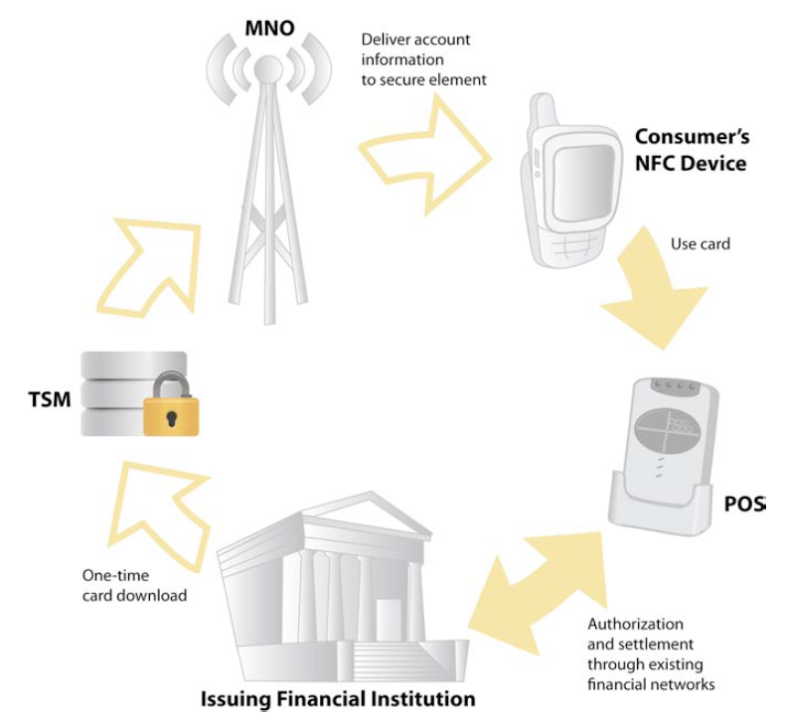
Mobile Payment Ecosystem
MOBILE
NETWORK
OPERATOR
NEAR-FIELD
COMMUNICATION
TRUSTED
SERVICE
MANAGER
POINT-OF-SALE
SOURCE: SMART CARD ALLIANCE
Notes:
52

Slide 43
The Secure Element
SOURCE: GEMALTO
Notes:
52

Slide 44
MCP = MOBILE
CONTACTLESS
PAYMENT
POI = POINT OF
INTERACTION
PSP = PAYMENT
SERVICE
PROVIDER
SEPA = SINGLE
EUROPEAN
PAYMENTS
AREA
SOURCE: EUROPEAN PAYMENTS COUNCIL
Notes:
52

Slide 45
Scan-Based Trading

Slide 46
Traditional Supply Chain
Supplier
Warehouse
Store
DC
BkRm
CkOut
Consumer
Terms begin
scanner
Supplier's revenue point:
Warehouse checkin
Retailer's revenue point:
Point-of-sale scanner
SOURCE: TERESA BRASHEARS

Slide 47
Causes of Grocery Out of Stock
Store Personnel
Unaware of
OOS Condition -
Did Not Order Item
Replenishment From
Warehouse
54%
3%
8%
Backroom/Display
Inventory Not Restocked To Shelf
Shelf Capacity
Inadequate
16%
19%
Promotion, Forecasting
and Ordering
SOURCE: COCA COLA RETAILCOUNCIL INDEPENDENT STUDY, 1996

Slide 48
Scan Based Trading (SBT)
Supplier
Retailer
DC
BkRm
Merchandising
CkOut
Consumer
Terms begin
X
scanner
Supplier and retailer revenue:
TIME-LINKED TO POS
ALMOST SIMULTANEOUS
SOURCE: TERESA BRASHEARS

Slide 49
Scan-Based Trading
Supplier owns goods until they are sold
Supplier reports quantity delivered; no store checkin
When goods are scanned at point-of sale, supplier AND retailer are both paid
Risk of shrinkage (loss, theft) is shared

Slide 50
Scan-Based Trading Benefits
Grocery Manufacturers of America study (2000)
3-4% increase in sales
100% elimination of invoice deductions
Retailer savings of $5 - $10K per supplier per 100 stores (supplier saves $4K - $20K per 100 stores)
Shrink is low, about 0.3%
Wal-Mark is the largest grocery chain in the U.S.
Wal-Mart keeps $50 billion of goods (total) in inventory
SOURCE: viaLINK

Slide 51
Wal-Mart Supply Chain Management
Satellite
Retailer HQ
POMS
MDSS
Data
Scan
Data
Supplier HQ
R.L.D.S.
Warehouse
Warehouse
shipper
Store
P.O.S.
Scanning
MDSS = MGMT DECISION SUPPORT SYSTEM
POMS = PRODUCTION & OPS MGMT SYSTEM
POS = POINT OF SALE
RLDS = RAPID LEAN DEPLOYMENT SYSTEM
SOURCE: HAK & PARTNERS

Slide 52
Paying for Scan-Based Trading
Large retailers may have more than 1 million SKUs (stock-keeping units) and 100,000 suppliers\
Not all items are SBT items (which ones are?)
Making daily payments to so many suppliers is a major payment problem
Each supplier my give different discounts based on its contract with Wal-Mart
Need data to compute the payments
Need a mechanism to make a large number of payments per day

Slide 53
Possible Task 16 Payment Methods
C2B
  Credit card, debit card
  Apple Pay, Android Pay
  PayPal
  Bitcoin
B2B
  Wire transfer (Fedwire or equivalent)
  Credit transfer (ACH credit)
  PayPal
You may use another method if you want to, BUT if you do not use one (or more) of the above you will need to justify your choice thoroughly

Slide 54
Q
A
&

Slide 55
Tokenization
REPLACING SENSITIVE DATA WITH A PROXY (SUBSTITUTE) – A “TOKEN”
1. Application collects or generates a piece of sensitive data.
2. Data is sent to the tokenization server, NOT stored locally.
3. Tokenization server generates a random token. Sensitive data and token are stored in a highly secure and restricted database (usually encrypted).
4. Tokenization server returns the token to the application.
5. Application stores the token, NOT the original value. Application uses the token for most transactions.
6. When the sensitive value is needed, an authorized application can request it from the tokenization server. Only authenticated requests will be honored.
SOURCE: SECUROSIS
Notes:
52

Slide 56
Using a Token
1. Retail customer swipes card at PoS.
2. PoS encrypts PAN with the public key of the payment processor’s tokenization server.
3. Transaction information (including the PAN, other card data, transaction amount, and merchant ID) are encrypted and transmitted to the
payment processor.
4. Payment processor’s tokenization server decrypts the PAN and generates a token. If this PAN is already in the token database, either reuse the existing token (multi-use), or generate a new token specific to this transaction (single-use).
SOURCE: SECUROSIS
Notes:
52

Slide 57
Using a Token
5. Token, PAN data, and possibly merchant ID are stored in the tokenization database.
6. PAN is used by the payment processor’s transaction systems for authorization and charge submission to the issuing bank.
7. Token is returned to the merchant’s payment systems, as is the transaction approval/denial, which hands it off to the PoS terminal.
8. Merchant stores the token with the transaction information in their systems/databases. For the subscribing merchant, future requests for settlement and reconciliation to the payment processor reference the token.
SOURCE: SECUROSIS
Notes:
52

Slide 58
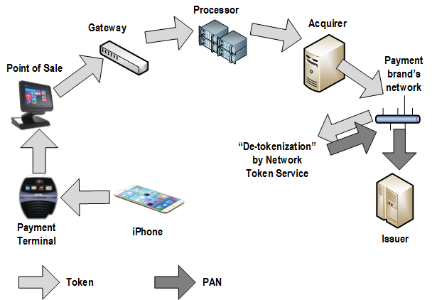
iPhone,
iWatch
Notes:
52

Slide 59
Apple Pay Enrollment
CARD INFO
SENT TO APPLE
0. USER IMAGES
CARD WITH
CELLPHONE
2. APPLE
VERIFIES CARD
WITH ISSUER
4. TOKENIZED ACCOUNT
NUMBER IS STORED IN
SECURE ELEMENT (SE).
WILL ONLY WORK FROM
THIS DEVICE.
4. TOKEN PROVIDER
SENDS DEVICE-SPECIFIC
TOKENIZED ACCOUNT
NUMBER TO APPLE SERVER
3. TOKEN PROVIDER
GETS APPROVAL
FROM ISSUER
NO ONE ELSE EVER RECEIVES
THE CREDIT CARD NUMBER
SOURCE: UNDERWRITERS LABORATORIES
Notes:
52

Slide 60
Apple Pay Proximity Payments
SOURCE: UNDERWRITERS LABORATORIES
Notes:
52

Slide 61
Apple Pay Remote Payments
SOURCE: UNDERWRITERS LABORATORIES
Notes:
52

Slide 62
Apple Pay With Fingerprint (Touch ID)
SOURCE: W. CAPRA CONSULTING
Notes:
52

Slide 63
B2B Payments

Slide 64
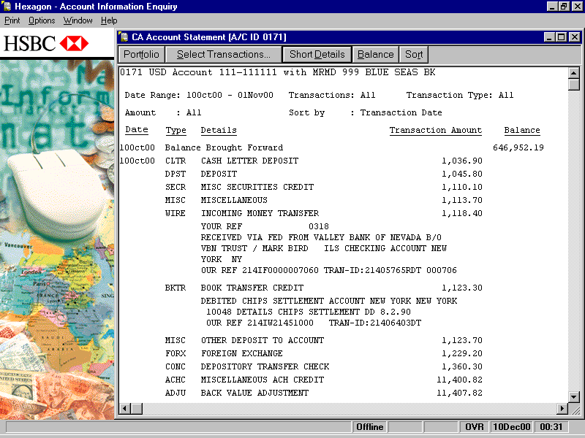
B2B Payments -- HSBC Hexagon
Another possibility (not using SWIFT directly) is to communicate orders to a bank with branches around the world,
like HSBC

Slide 65
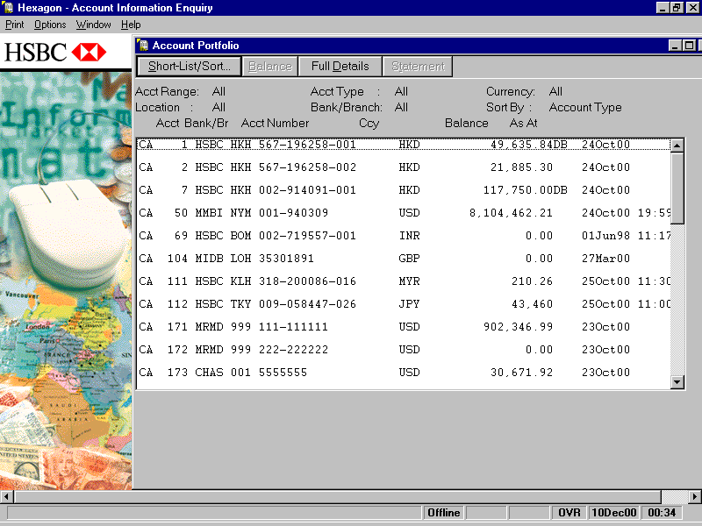
HSBC Hexagon

Slide 66
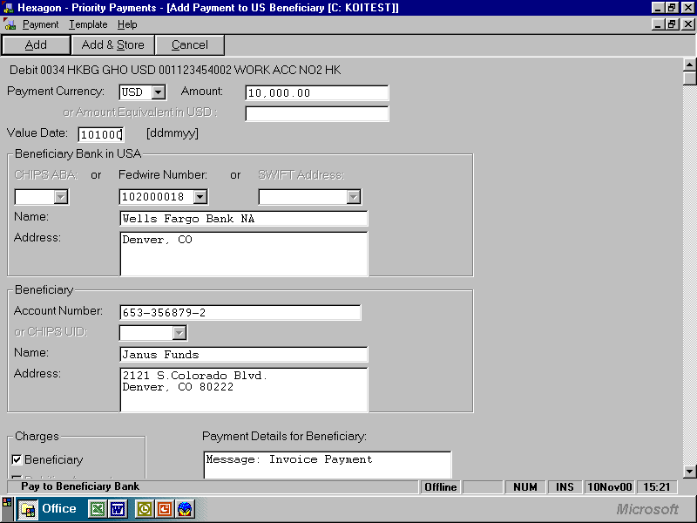
HSBC Hexagon Payment

