Slide 1


Task 16
Instant Payments at Wal-Mart
Michael I. Shamos, Ph.D., J.D.
Director, eBusiness Programs
Institute for Software Research
Carnegie Mellon University

Slide 2
Outline
How Payments are Made
  Payments between banks
  The Automated Clearing House (ACH)
Financial messaging
  SWIFT (Society for Worldwide Interbank Financial Telecommunication)
Integration with ERP and Accounts Payable

Slide 3
The Fundamental Payment Problem
Parties cannot pay each other directly, except in cash¹
Payment
Buyer’s
Bank
Seller’s Bank
How does one bank
pay another bank?
Advice of
payment (AOP)
Payment
order
Messaging &
Trade Information
BUYER
SELLER
¹Or possibly in Bitcoin, which they don’t do
SOURCE: DEBRA MITTERER

Slide 4
Central Banks
The U.S. central bank is the Federal Reserve Bank
  PRC: People’s Bank of China (PBOC)
  India: Reserve Bank of India
Commercial banks hold very little cash (just enough for tellers and ATMs)
Commercial banks have accounts at the central bank
Most bank money is not in cash, but is a ledger entry (account) in a database at the central bank
For example, there is about $1.5 trillion in U.S. cash in the world, but U.S. banks hold almost $14 trillion in their accounts
Notes:
52

Slide 5
How Banks Pay Each Other
They keep most of their money in the central bank
They give instructions to the central bank to “move money” by updating their accounts in the central bank
If Citibank wants to move USD 1 million to PNCBank, it sends an order to the central bank:
ACCOUNTS AT
THE CENTRAL BANK
PNCBANK
BANK A
. . .
BANK Z
CITIBANK
ACCOUNTS AT
THE CENTRAL BANK
PNCBANK
BANK A
. . .
BANK Z
CITIBANK
1,134,299,321
1,135,299,321
USD
1,000,000
2,107,071,775
2,106,071,775
BEFORE TRANSFER
AFTER TRANSFER

Slide 6
Fedwire: How Banks Pay Each Other
Central banks maintain “real-time gross settlement systems (RTGS) to execute payment instructions quickly
The Federal Reserve RTGS is called Fedwire
“Real-time” means less than 1 minute
“Gross settlement” means that each order is processed as it is received. No batching
These payments are called “wire transfers”
RTGS payments are expensive: up to USD 50 per payment
Used mainly for large amounts (average on FedWire: USD 3.5M)
Notes:
52

Slide 7
How Fedwire Works
EVERGEEN BANK
(SEATTLE)
PNC WANTS TO TRANSFER
$1M TO EVERGREEN BANK
PNC BANK
(PITTSBURGH)
9. SEATTLE BRANCH NOTIFIES
EVERGREEN. PAYMENT IS
NOW IRREVOCABLE.
1. PNC SENDS TRANSFER ORDER
TO PITTSBURGH BRANCH OF
CLEVELAND FED
SAN FRANCISCO FED
(SEATTLE BRANCH)
CLEVELAND FED
(PITTSBURGH BRANCH)
8. SF FED NOTIFIES
SEATTLE BRANCH
2. PITTSBURGH BRANCH SENDS
ORDER TO CLEVELAND FED
INTERDISTRICT
SETTLEMENT FUND
ATLANTA FED
BOSTON FED
CLEVELAND FED
. . .
SAN FRANCISCO FED
SAN FRANCISCO FED
EVERGREEN BANK
. . .
WELLS FARGO
WESTERN BANK
6. ISF NOTIFIES
SF FED
4. CLEVELAND
SENDS ORDER
TO ISF
CLEVELAND FED
DOLLAR BANK
MELLON BANK
. . .
PNC BANK
7. SF FED ADDS $1M TO
EVERGEEN ACCOUNT
5. ISF SUBTRACTS $1M FROM
CLEVELAND, ADDS $1M TO SF
3. CLEVELAND FED SUBTRACTS
$1M FROM PNC ACCOUNT
Notes:
52

Slide 8
Net Settlement
Most consumer (small) payments, such as ATM and credit card transactions are not made in real-time with RTGS
The data is sent to a clearing house
Clearing house keeps track of the net amounts owed or owing from bank to bank
Each transaction causes these amounts to be adjusted
After a clearing period (e.g. 1 day), each bank is told the total amount it must pay or will receive
Banks then use RTGS (in the U.S., Fedwire) to settle their TOTAL debts with ONE payment each
Notes:
52

Slide 9
Net Settlement
Many payments are small and do not have to be made in real-time. The cost of RTGS is not justified
Payments can be batch and settlement made for the whole batch later
Net settlement through an automated clearing house (ACH) is used for:
  credit/debit cards
  checks
  ATM withdrawals, credit transfers
BUT: there is no upper limit on ACH payments
Cost is low: about USD 0.10 per payment, 500 times cheaper than RTGS
Notes:
52

Slide 10
Payment Orders
An instruction to a financial institution to make a payment
Must specify:
  Amount & currency
  Bank FROM which payment is made (payor or drawee bank)
  Account number FROM which payment is made
  Bank TO which payment is to be made (payee bank)
  Account number TO which payment is to be made
Payment orders are often sent electronically to the clearing house as “ACH files”
These payment orders are NOT settled individually. They are BATCHED to determined their net effect
Notes:
52

Slide 11
Clearing Payment Orders
CUSTOMER CMU
OF MELLON BANK
1. CMU SENDS CHECK TO SHAMOS
CUSTOMER SHAMOS
OF CITIBANK
“PAY SHAMOS $100”
9. MELLON SENDS
CHECK BACK TO CMU
2. SHAMOS DEPOSITS
CHECK AT CITI
MELLON BANK
CUSTOMER A
CUSTOMER CMU
. . .
CUSTOMER Y
CUSTOMER Z
8. CLEARING HOUSE
SENDS CHECK TO
MELLON
CITIBANK
CUSTOMER A
CUSTOMER B
. . .
SHAMOS
CUSTOMER Z
4. CITI SENDS CHECK
TO CLEARING HOUSE
-100
AUTOMATED
CLEARING HOUSE
MELLON
BANK A
. . .
BANK Z
CITIBANK
+100
-100
7. MELLON
DEDUCTS $100
FROM CMU
ACCOUNT
6. CLEARING
HOUSE SENDS MELLON
DEBIT INFO
3. CITIBANK CREDITS
SHAMOS WITH $100
+100
5. CLEARING HOUSE ADDS $100 TO CITI,
SUBTRACTS $100 FROM MELLON

Slide 12
Settling Payment Orders
1. AT END OF DAY, EACH
BANK HAS A NET POSITIVE
OR NEGATIVE CLEARING
HOUSE BALANCE
REAL-TIME GROSS
SETTLEMENT SYSTEM
(FEDWIRE)
MELLON
BANK A
. . .
BANK Z
CITIBANK
CLEARING
HOUSE
    2. BANKS WITH NEGATIVE
BALANCES MUST PAY;
THOSE WITH POSITIVE
BALANCES RECEIVE
MONEY
+34,299,321
6. CLEARING HOUSE PAYS
MELLON $34,299,321
4. CITI PAYS THE CLEARING
HOUSE THROUGH RTGS
-107,071,775
MELLON BANK
CUSTOMER A
CUSTOMER CMU
. . .
CUSTOMER Y
CUSTOMER Z
CITIBANK
CUSTOMER A
CUSTOMER B
. . .
SHAMOS
CUSTOMER Z
+107,071,775
-15085
+2786
+3167
AUTOMATED
CLEARING HOUSE
MELLON
BANK A
. . .
BANK Z
CITIBANK
-988713
+728103
+100
+35529
+34,299,321
-31872
5. CLEARING HOUSE ADVISES
MELLON IT WILL
RECEIVE $34,299,321
3. CLEARING HOUSE INFORMS
CITI IT MUST PAY $107,071,775
-107,071,775

Slide 13
Gross Settlement
CENTRAL BANK
BUYER’S
BANK
SELLER’S
BANK
SELLER
BUYER

Slide 14
Gross Settlement
CENTRAL BANK
3. CENTRAL BANK ADJUSTS BALANCES
OF BUYER’S BANK AND SELLER’S BANK
2. BUYER’S BANK USES
FEDWIRE TO ASK FED TO
MOVE MONEY FROM BUYER’S
BANK TO SELLER’S BANK
4. CENTRAL BANK NOTIFIES SELLER’S
BANK OF TRANSACTION
BUYER’S
BANK
SELLER’S
BANK
1. BUYER SENDS PAYMENT
ORDER (WIRE TRANSFER)
TO BUYER’S BANK
5. SELLER’S BANK NOTIFIES
SELLER OF RECEIPT OF
MONEY
SELLER
BUYER

Slide 15



Net Settlement
CENTRAL BANK
BUYER’S
BANK
SELLER 1 BANK
SELLER 1
SELLER 2 BANK
SELLER 2
BUYER
SELLER 3 BANK
SELLER 3

Slide 16
Net Settlement, Part 1
CENTRAL BANK
RED INDICATES A PAYMENT OUT (DEBT)
GREEN INDICATES A PAYMENT IN
BUYER’S
BANK
2. BUYER’S BANK SENDS
ACH TRANSACTIONS
TO CLEARING HOUSE
SELLER 1 BANK
SELLER 1
1. BUYER SENDS ACH
FILE (CREDIT
TRANSFERS) TO
BUYER’S BANK
4
4
SELLER 2 BANK
SELLER 2
3. CLEARING HOUSE CONTINUOUSLY
DETERMINES THE NET EFFECT OF
ALL TRANSFERS
4. AT END OF DAY, CLEARING HOUSE
TELLS EACH DEBTOR BANK HOW
MUCH IT MUST PAY
BUYER
SELLER 3 BANK
SELLER 3

Slide 17
Net Settlement, Part 1
RED INDICATES A PAYMENT OUT
GREEN INDICATES A PAYMENT IN
CENTRAL BANK
6. BUYER’S BANK (WHICH MAY
BE A DEBTOR, SENDS AN
ORDER BY FEDWIRE
7. SELLER BANK 1 (WHICH MAY
ALSO BE A DEBTOR) SENDS AN
ORDER BY FEDWIRE
8. FED CREDITS THE
CLEARING HOUSE
WITH FUNDS FROM
BUYER’S BANK AND
SELLER BANK 1
BUYER’S
BANK
SELLER 1 BANK
SELLER 1
SELLER 2 BANK
SELLER 2
5. DEBTOR BANKS PAY THE CLEARING
HOUSE BY FEDWIRE
BUYER
SELLER 3 BANK
SELLER 3

Slide 18
Net Settlement, Part 2
CENTRAL BANK
RED INDICATES A PAYMENT OUT
GREEN INDICATES A PAYMENT IN
11. FED CREDITS THE
ACCOUNTS OF THE
CREDITOR BANKS
AND NOTIFIES THEM
OF PAYMENT
12. CREDITOR BANKS
NOTIFY SELLERS
OF PAYMENT
BUYER’S
BANK
10. CLEARING HOUSE
SENDS ORDERS
TO THE FED BY
FEDWIRE
SELLER 1 BANK
SELLER 1
SELLER 2 BANK
SELLER 2
9. CLEARING HOUSE PAYS THE CREDITOR
BANKS BY FEDWIRE
IN NET SETTLEMENT,
EVERY BANK MAKES OR
RECEIVES EXACTLY ONE
PAYMENT !
BUYER
SELLER 3 BANK
SELLER 3

Slide 19
Financial Messaging
Money never actually moves, except in cash form
Most money is transferred by sending messages – payment orders – to and from banks
Banks also send messages to their customers to advise of payments
Financial messaging is ESSENTIAL to payment systems
BUT: a financial message is NOT a settlement

Slide 20
S.W.I.F.T.
Society for Worldwide Interbank Financial Telecommunication
Non-profit, headquarters in Brussels
Financial messaging system ONLY
  NOT A PAYMENT SYSTEM
  No accounts, no clearing, no settlement
  Settlement must occur separately
4.6 billion messages/yr
Amounts in messages: USD 7 trillion value per day
Cost ~ $0.20 per message; transit time 20 seconds
Private IP network, NOT the Internet
SOURCE: SWIFT
Notes:
52

Slide 21
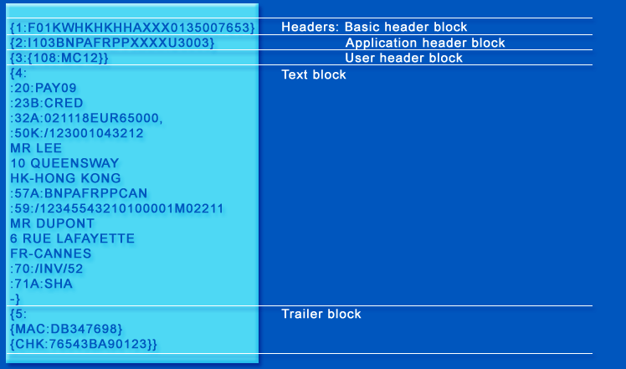
A SWIFT Message
103 = REMITTANCE
108 = MESSAGE REF
:20 TRANSACTION REF #
:23B BANK OPERATION: CREDIT
:32A VALUE DATE, CURRENCY, AMOUNT
:50K ORDERING INSTITUTION
:57A ACCOUNT WITH INSTITUTION
:59 RECIPIENT
:70 REMITTANCE INFORMATION, REASON FOR PAYMENT
:71A DETAILS OF CHARGES.
SHA = SHARED TRANSFER CHARGES
MAC = MESSAGE AUTHENTICATION CODE
CHK = CHECKSUM

Slide 22
SWIFT E-payments Plus System
Buyer's bank
Seller's bank
Payment
SWIFTNet
Link
SWIFTNet
Link
SWIFTNet
Payments
application
Payments
application
Payment Initiation
Initiation Response
Initiation
Confirmation
e-paymentPlus
Payment Initiation
Initiation
Confirmation
Initiation
Confirmation
TrustAct Server
TrustAct
Link
TrustAct
Link
Remittance advice
Remittance advice
Remittance advice
Invoices
Buyer
Seller
Internet
SOURCE: SWIFT

Slide 23
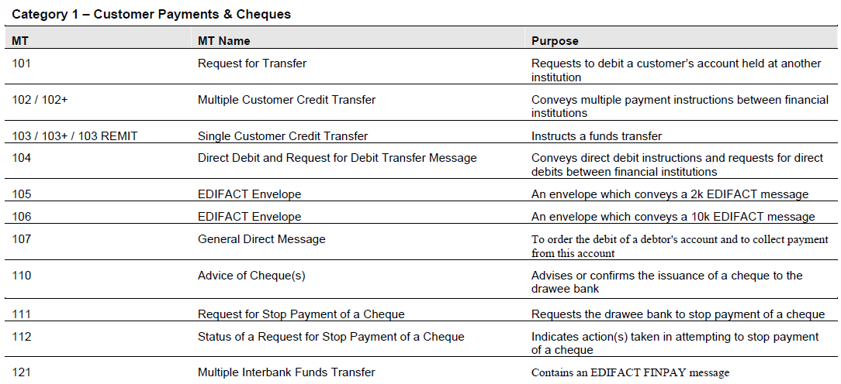
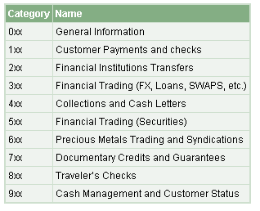
SWIFT Message Types
SEE ALL MESSAGE TYPES
Notes:
52

Slide 24
ISO 20022 Financial Messaging
UNIFI = UNIversal Financial Industry message scheme
International Standards Organization (ISO) 20022
XML-Based
MANY FORMATS ARE USED FOR FINANCIAL
MESSAGING:
EDIFACT = Electronic Data Interchange for
Administration Commerce and Transport
FpML = Financial Products Markup Language
IFX = International Financial Exchange
OAGI = Open Applications Group Interface
RosettaNet
SWIFT = Society for Worldwide Interbank
Financial Telecommunications
TWIST = Transaction Workflow Innovation
Standards Team
A GOAL OF ISO 20022 IS TO UNIFY THEM
SOURCE: TREASURY TODAY
Notes:
52

Slide 25
Notes:
52

Slide 26
ISO 20022 Message Format
ExampleBank in Utrecht, the Netherlands
(Bank Identifier Code (BIC) EXABNL2U)
has been requested by its customer
(ACME NV, Amstel 344, Amsterdam)
to transfer 12,500 US Dollars from
its account 8754219990
on 29 October 2009 (settlement date).
Instead sending unstructured text
to its US Dollar correspondent,
ExampleBank sends a structured
message based on ISO 20022.
SOURCE: ISO 20022 FOR DUMMIES
Notes:
52

Slide 27
Mapping SWIFT to ISO 20022
SOURCE: ISO 20022 FOR DUMMIES
Notes:
52

Slide 28
Instant Payments

Slide 29
Instant Payment
Idea: allow instant crediting of money to a recipient
Problem: banks can only pay each other through the central bank – expensive
Solution: a trust network. The receiver’s bank TRUSTS the sender’s bank to pay at the end of the day
Receiver’s bank is willing to credit the receiver immediately
Notes:
52

Slide 30
Instant Payments
SENDER
RECEIPIENT
TOTAL TIME:
A FEW
SECONDS!
SOURCE: CAPSYS
Notes:
52

Slide 31
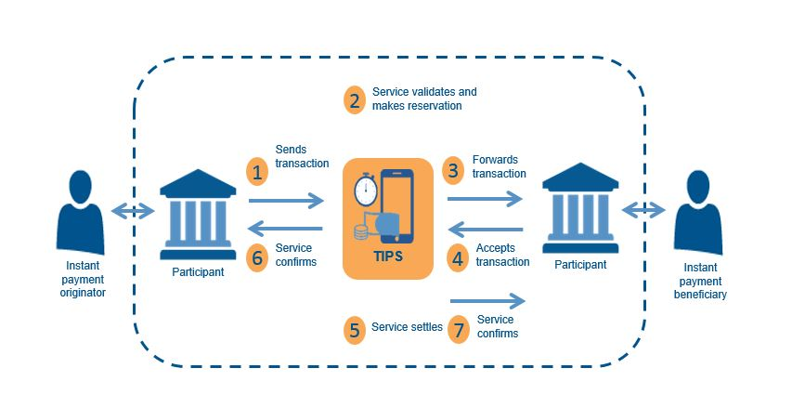
Instant Payments
SOURCE: EUROPEAN PAYMENTS COUNCIL
Notes:
52

Slide 32
Instant Payment Worldwide
SOURCE: FISGLOBAL
Notes:
52

Slide 33
ERP Integration

Slide 34
Integrating Payments with Upstream Processes
Buyer
Seller
Purchasing
Dept.
Sales
Dept.
Purch
Order
PO
No.
Receiving
Dept.
Ship &
Invoice
Shipping
& Invoicing
Dept.
PO
No.
Invoice
No.
Accounts
Payable
AOP,
Payment
Accounts
Receivable
Invoice
No.
Payment
No.
SOURCE: COMMERCENET

Slide 35
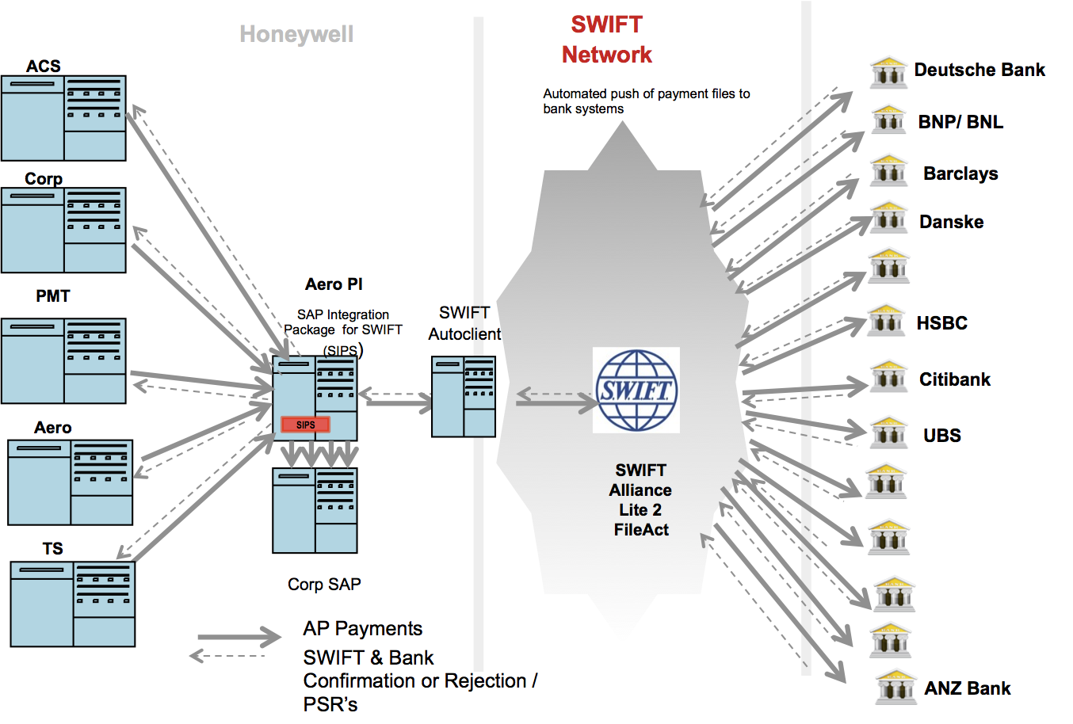
Automated Accounts Payable
HONEYWELL
BUSINESS
UNITS
SOURCE: HONEYWELL (THROUGH CTMFILE)
Notes:
52

Slide 36
Q
A
&

